Slide 1
Microsoft Azure
Azure Cloud Infrastructure
& Terraform Design
Secure, Scalable Healthcare Platform on Microsoft Azure
01 / 15

Slide 2
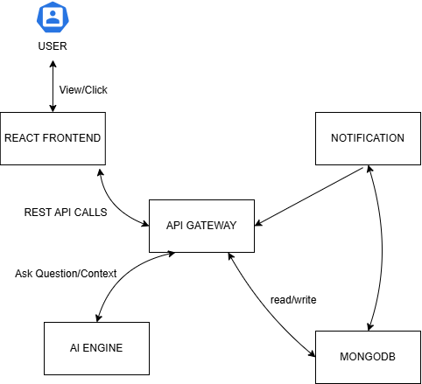

Slide 3
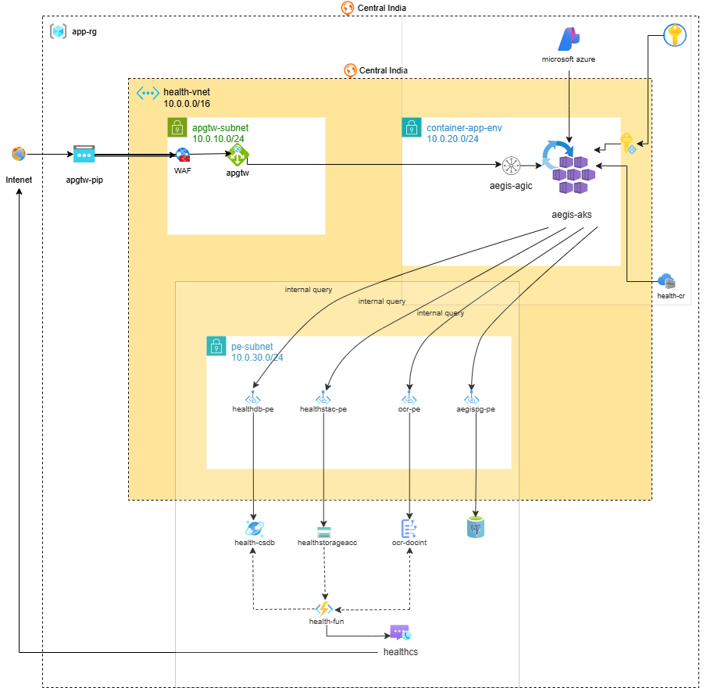

Slide 4
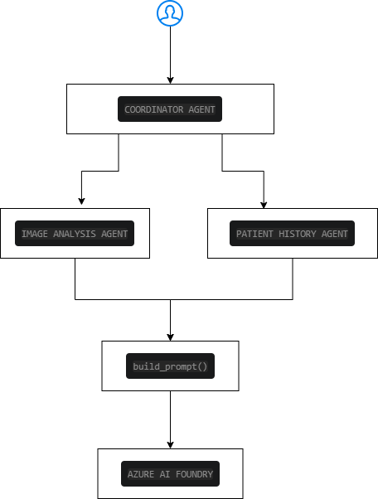

Slide 5
AI & Event Processing Layer
07 / 15
🤖
Azure AI Document Intelligence
⚡
Azure Functions
OCR & text extraction
Event-driven processing
Structured data from unstructured docs
Serverless compute model
Form & table recognition
Workflow automation
Healthcare document parsing
Trigger on blob upload or queue
Design Pattern
Upload Event
→
Function Trigger
→
OCR Processing
→
Database Update

Slide 6
Key Design Decisions
14 / 15
🌐
🛡️
📦
Secure Ingress
WAF Protection
Containerized
Application Gateway as single entry point
OWASP rules defending all public endpoints
Microservices via Azure AKS
☁️
⚡
Managed Services
Event-Driven
Cosmos DB, Functions, Comm. Services
Azure Functions for async processing

Slide 7
Conclusion & Outcomes
🛡️
Secure Architecture
WAF + Private Endpoints + Managed Identity eliminate common attack vectors
📈
Scalable Infrastructure
Container Apps and Cosmos DB scale independently to meet demand
🤖
Automated Provisioning
Terraform modules deploy the full stack consistently across environments
🎯
Simplified Operations
Managed services reduce infrastructure toil and operational overhead
🏢
Enterprise-Ready Design
Compliant, observable, and maintainable for production workloads
15 / 15

